Slide 1
Predicting the best zone for investment in an apartment for rent

Slide 2
Predicting an investment zone is valuable for investors
Investing in an apartment to later rent it is an investment with almost certain returns because year after year the number of people looking for a place to live increases mainly in large cities such as Mexico City.
Coyoacan is a delegation from Mexico City that is growing economically every year. In addition to this, the culture that exists in this place is attractive to encourage people to live here. For this reason, it should be considered as an area to invest in an apartment.
To help decision-making, a machine learning model can be considered that considers factors such as size, number of rooms, location area, and nearby places of interest.

Slide 3
Data acquisition
Mercado libre is a page designed for the sale of various products, in particular it contains information on apartments for sale and rent in different areas of Mexico.
We applied scrapping methods to this page to obtain information about apartments for rent and for sale in Coyoacán.
We obtained information about the places of interest near to each apartment through Foursquare API.

Slide 4
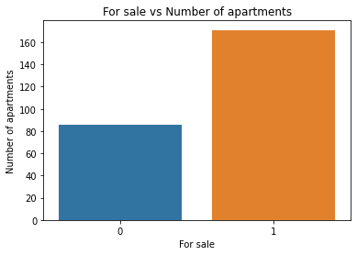
Splitting the data
The data set was divided into two categories: apartments for rent and apartments for sale.

Slide 5
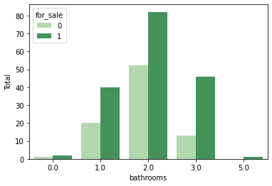
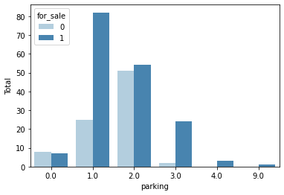
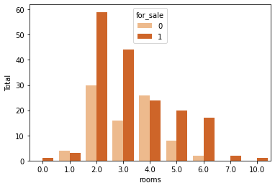
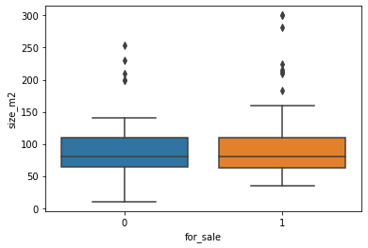
Main characteristics of the departments
Bathrooms
Parking places
Size (m2)
Rooms

Slide 6
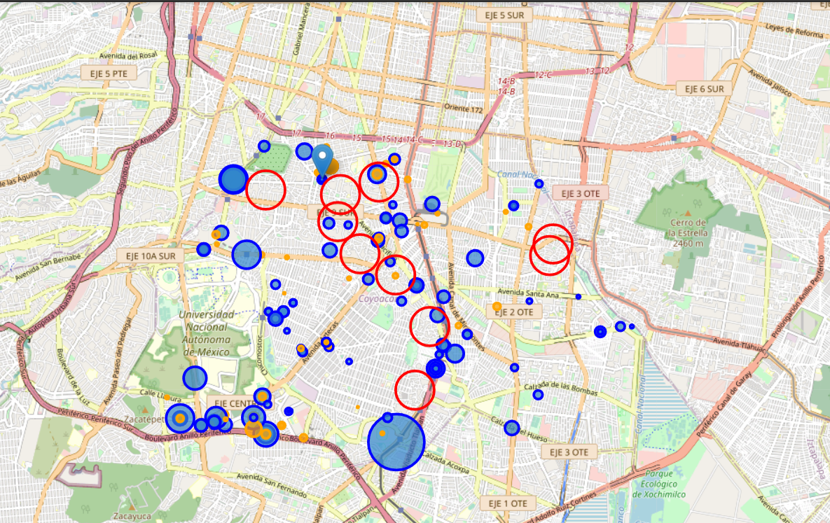
Viewing both apartment categories
In this map the blue circles are the sale apartments, and the orange circles are the rent apartments. The size of the circles is in proportion with the price. The red circles are the principal neighborhoods of Coyoacan.
We can see that the biggest circles are near to the greats avenues like 'Calzada de Tlalpan' or 'Circuito interior'. This makes us think that the idea about the price is in relation with the location is good

Slide 7
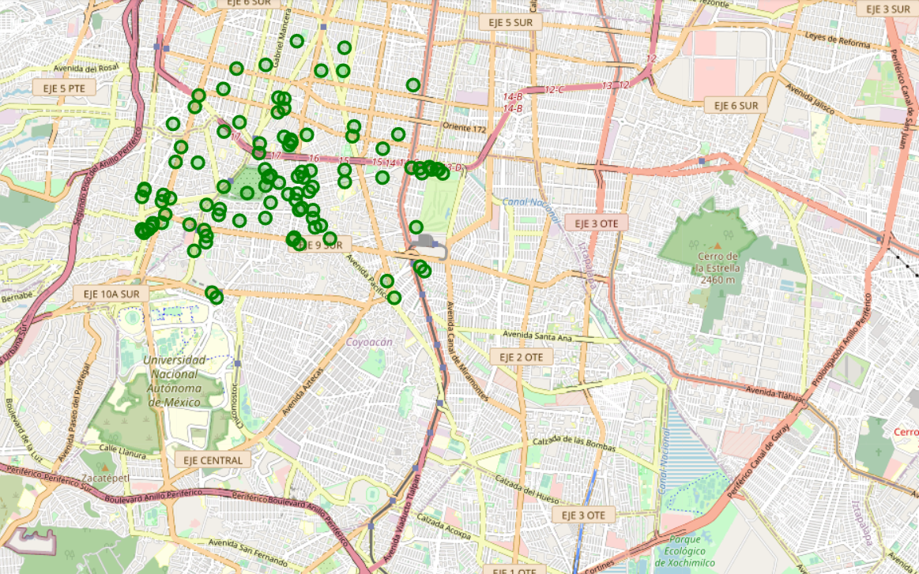
Places of interest
Most of the interesting places are located at north of Coyoacan.

Slide 8
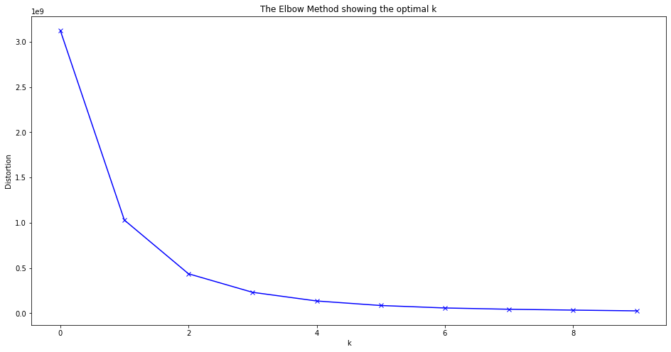
Classification Model (rent)
We have applied a clustering algorithm on the data in both categories (apartments for rent and for sale)
Elbow method indicates tha the optimal number of clusters is 2

Slide 9


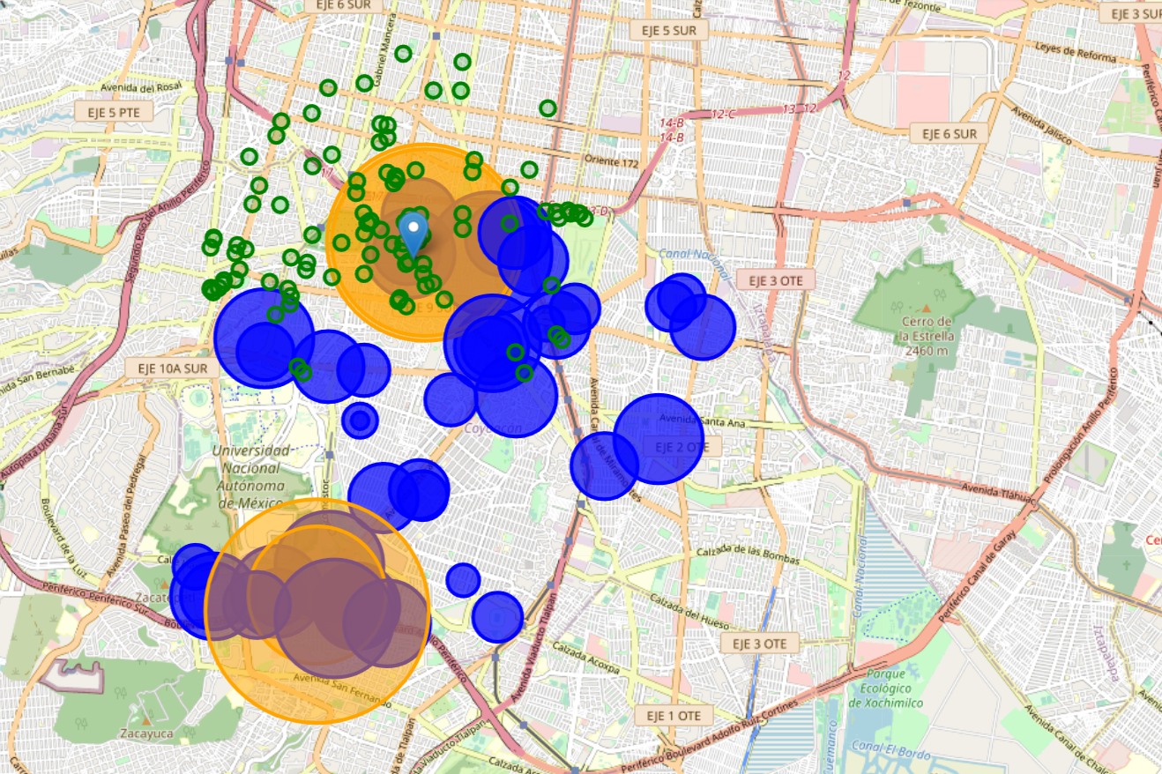

Labeling apartments for rent
In this the blue circles are the label 0, the lowest prices for rent and the orange circles are the label 1, the highest prices for rent. We can see the the highest prices are at north and south near to great avenues. We are interested in the apartments located at north because here are the interesting places.

Slide 10
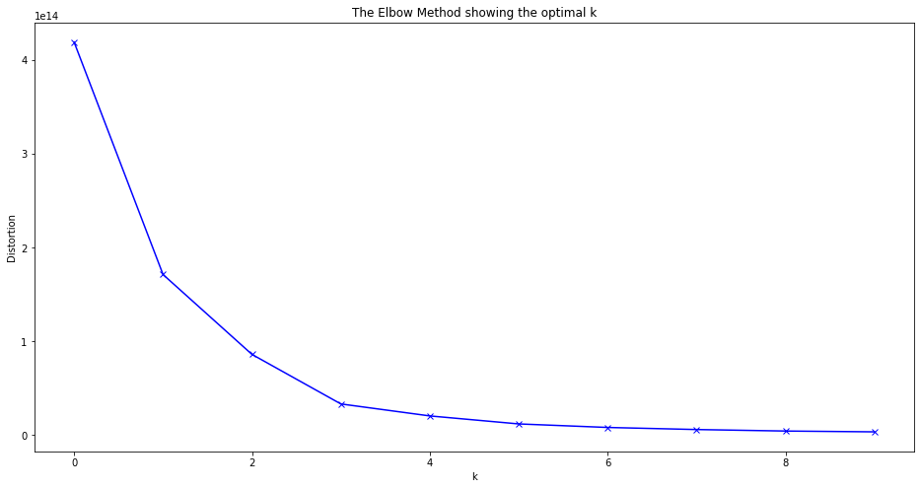
Classification Model (sale)
Elbow method indicates tha the optimal number of clusters is 2

Slide 11
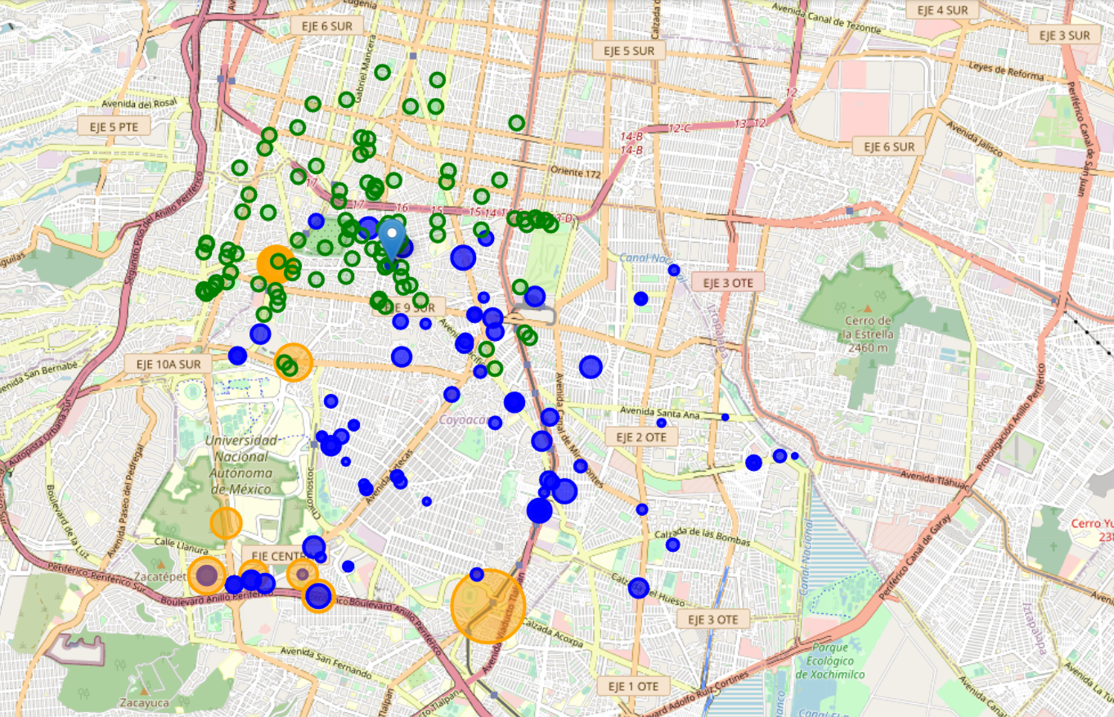
Labeling apartments for sale
In this the blue circles are the label 0, the lowest prices for sale and the orange circles are the label 1, the highest prices for sale. We can see the lowest prices are at north. This is so good because at this zone are the apartments with the highest rental prices, the perfect combination. This coincides with the location of the interesting places. Our theory was right, the best zone for invest in an apartment for rental is in correlation with the location.

Slide 12
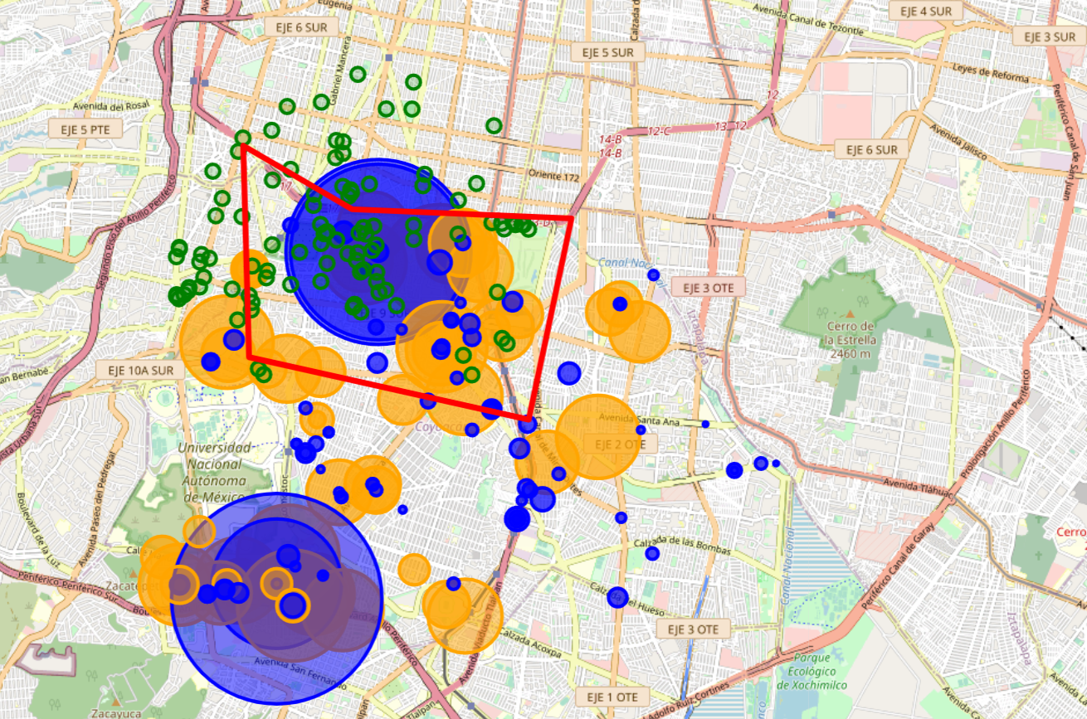
Merging information

Slide 13
Conclusions
In the last map, as in the previous ones, the green circles indicate places of interest (restaurants, cafes, etc.). The blue circles are points where there are apartments for sale with the lowest prices and apartments for rent with the highest prices. While the orange circles are points where there are apartments for sale with high prices and apartments for rent with low prices.
In the red polygon, there would be a great investment opportunity, since it presents a great density of places of interest, at the same time that it presents a great density of blue points. Which indicates that you could buy apartments at the lowest prices in the area and put them up for rent at the highest prices in the area. In addition, the size of the orange circles is medium, which indicates that also, in this area, the highest prices for sale, these are not the highest and the lowest prices for rent, these are not the Lower. For these reasons we believe that this area presents the best investment opportunity for someone who wants to invest in real estate.

